Slide 1



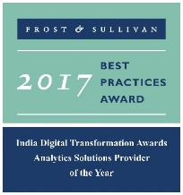


An Introduction
External Data Sources
Augmenting Financial Insights
December 2017
Actionable Insights. Accurate Decisions
2009-2016

Slide 2
Vision of Services
Objective
Develop suite of services for customers – Mutual Funds, ETF’s, Hedge Funds Portfolio Managers
Services would help fund managers rebalance portfolio’s
New services would combine financial data along with new data types; consumer sentiment
External data, combined with financial metrics improve the returns for fund managers.
Open the door for new suite of services for State Street
LatentView to Partner with State Street

Slide 3




Vision of Services
New Suite of Services
External Data Sources
Increase Customer Loyalty
Services would help fund managers rebalance portfolio’s
External data combined with financial data will power new services
New value added services improves customer loyalty
Develop suite of services for customers – Mutual Funds, ETF’s, Hedge Funds Portfolio Managers

Slide 4





Data Sources for Investment Advisory Services
Data Sources
Sample Use Cases
Stock Prices, Company Fundamentals, Institutional Holdings, ETF Fund Flow, Industry Metrics, Forex Prices, Index History
Simulation models to understand the influence of different financial, macroeconomic, industry factors on investment portfolios
Real time/ Hourly/ Daily
Structured
Data Marketplace
Analyst ratings and reports about various listed companies. Covers historical rating and buy/sell recommendations
Benchmark analyst accuracy, identify any underlying bias in ratings and recommendations and correct for bias in portfolio prediction models
Analyst Reports
Daily/ Weekly
Company events information including new product/service announcements, leadership change, awards, job posting
Increased job postings for Amazon Web Services could be indicative of increased business expansion leading to more earnings and higher stock price for Amazon in the next two quarters
Company Websites
Daily
Unstructured Data
Relevant news about companies, industries, markets covering legal complications, policy changes, new initiatives etc.
News about Whole Foods acquisition by Amazon has an effect on stock prices of online and offline retailers and should be used to adjust valuations for relevant equities, indices and ETFs
News Aggregators
Hourly
Real time updates of critical events, expert opinions, public sentiment, marketing campaigns
Negative sentiment around increase in Netflix subscription fees could result in customer churn leading to lesser than expected earnings increase necessitating a downward adjustment on valuation
Social Media
Near real time

Slide 5
CPG F&B Analysis - Approach

Slide 6









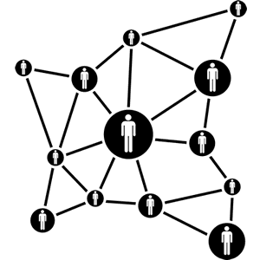





CPG F&B - Impact drivers
Demand Impact index
Supply impact index
Customer Experience Impact
Index
Demand size
Ingredient cost
Lifestyle trends
Demand volatility
Logistic cost
Perception Analysis
Shifting Consumption patterns
Labor market
Touchpoint trends
Macroeconomic shifts
Regulations
Personalization
Notes:
References:
https://www.thinkwithgoogle.com/intl/en-gb/advertising-channels/emerging-technology/beauty-on-youtube-be-part-of-the-conversation/
https://fortunelords.com/youtube-statistics/
https://www.statista.com/statistics/264810/number-of-monthly-active-facebook-users-worldwide/

Slide 7




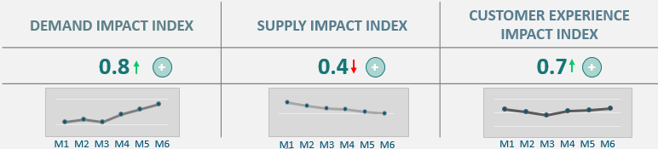
Analytical Platform – Snapshot (1/9)
ILLUSTRATIVE
Fund analysis
.
Fund:
Principal XYZ fund
Sector:
All
Asset Class
Equity
Timeframe
All
3-month
6 - month
Fund Holdings(Top 10) | % Portfolio | Market Value
Walgreens | 12.75 | $26,500
Kellogg | 10.5 | $20,100
Toyota Moto Corp | 8.34 | $15,000
Lloyds banking Corp | 7.31 | $18,000
Citi corp. | 7.00 | $17,800
PepsiCo | 6.5 | $15,600
Resmed Inc. | 6.1 | $14,900
Vanguard | 4.4 | $13,500
Hyundai Motor Corp | 4.3 | $12,500
Ford | 3.9 | $10,000
Cadbury | 3.8 | $9,800

Slide 8
Analytical Platform – Snapshot (2/9)
ILLUSTRATIVE
Fund analysis
.
All
Equity
Timeframe:
6 - month
Company:
All
3-month
6 - month
Sector:
Timeframe
Fund:
Principal XYZ fund
Asset Class
PepsiCo
BRAND PERCEPTION AS HEALTH FOOD IN NORTH AMERICA
Fund Holdings(Top 10) | % Portfolio | Market Value
Walgreens | 12.75 | $26,500
Kellogg | 10.5 | $20,100
Toyota Moto Corp | 8.34 | $15,000
Lloyds banking Corp | 7.31 | $18,000
Citi corp. | 7.00 | $17,800
PepsiCo | 6.5 | $15,600
Resmed Inc. | 6.1 | $14,900
Vanguard | 4.4 | $13,500
Hyundai Motor Corp | 4.3 | $12,500
Ford | 3.9 | $10,000
Cadbury | 3.8 | $9,800
Company:
PepsiCo
DEMAND IMPACT INDEX | 0.8 | SUPPLY INDEX | CUSTOMER EXPERIENCE INDEX
BRAND PERCEPTION AS HEALTH FOOD IN NORTH AMERICA | 0.8 | 0.4 | 0.7
ADHERENCE TO ENVIRONMENTAL INITIATIVES | 0.7
IMPACT OF INFLATION ON DEMAND DRIVERS IN APAC | 0.8
IMPACT OF CHANGING CONSUMPTION PATTERNS | 0.4
+
+
+
+
+

Slide 9
Analytical Platform – Snapshot (3/9)
ILLUSTRATIVE
Fund analysis
.
Fund:
Principal XYZ fund
Sector:
All
Asset Class
Equity
Timeframe
All
3-month
6 - month
Company:
PepsiCo
Timeframe:
6 - month
Fund Holdings(Top 10) | % Portfolio | Market Value
Walgreens | 12.75 | $26,500
Kellogg | 10.5 | $20,100
Toyota Moto Corp | 8.34 | $15,000
Lloyds banking Corp | 7.31 | $18,000
Citi corp. | 7.00 | $17,800
PepsiCo | 6.5 | $15,600
Resmed Inc. | 6.1 | $14,900
Vanguard | 4.4 | $13,500
Hyundai Motor Corp | 4.3 | $12,500
Ford | 3.9 | $10,000
Cadbury | 3.8 | $9,800
ADHERENCE TO ENVIRONMENTAL INITIATIVES
PepsiCo’s Environmental efforts
Effort
Associated Trend
Reduced Water Use
Upward
+
Reduce GHG emissions
Downward
+
PepsiCo’s Environmental efforts
HFC Free equipment
Steady
+
Effort
Associated Trend
Reduced Water Use
Upward
+
Reduce Carbon footprints
Steady
+
Reduce GHG emissions
Downward
+
HFC Free equipment
Steady
+
Reduce Carbon footprints
Steady
Company:
PepsiCo
+
DEMAND IMPACT INDEX | 0.8 | SUPPLY INDEX | CUSTOMER EXPERIENCE INDEX
BRAND PERCEPTION AS HEALTH FOOD IN NORTH AMERICA | 0.8 | 0.4 | 0.7
ADHERENCE TO ENVIRONMENTAL INITIATIVES | 0.7
IMPACT OF INFLATION ON DEMAND DRIVERS IN APAC | 0.8
IMPACT OF CHANGING CONSUMPTION PATTERNS | 0.4
+
+
+
+
+

Slide 10
Analytical Platform – Snapshot (4/9)
ILLUSTRATIVE
Fund analysis
.
Fund:
Principal XYZ fund
Sector:
All
Asset Class
Equity
Timeframe
All
3-month
6 - month
Company:
PepsiCo
Timeframe:
6 - month
Fund Holdings(Top 10) | % Portfolio | Market Value
Walgreens | 12.75 | $26,500
Kellogg | 10.5 | $20,100
Toyota Moto Corp | 8.34 | $15,000
Lloyds banking Corp | 7.31 | $18,000
Citi corp. | 7.00 | $17,800
PepsiCo | 6.5 | $15,600
Resmed Inc. | 6.1 | $14,900
Vanguard | 4.4 | $13,500
Hyundai Motor Corp | 4.3 | $12,500
Ford | 3.9 | $10,000
Cadbury | 3.8 | $9,800
IMPACT OF INFLATION ON DEMAND DRIVERS IN APAC
CPI Index - China
Unemployment rates - China
Company:
PepsiCo
CPI Index - India
DEMAND IMPACT INDEX | 0.8 | SUPPLY INDEX | CUSTOMER EXPERIENCE INDEX
BRAND PERCEPTION AS HEALTH FOOD IN NORTH AMERICA | 0.8 | 0.4 | 0.7
ADHERENCE TO ENVIRONMENTAL INITIATIVES | 0.7
IMPACT OF INFLATION ON DEMAND DRIVERS IN APAC | 0.8
IMPACT OF CHANGING CONSUMPTION PATTERNS | 0.4
+
+
+
+
+

Slide 11
Analytical Platform – Snapshot (5/9)
Analytical Platform – Snapshot (5/9)
ILLUSTRATIVE
Fund analysis
.
Fund:
Principal XYZ fund
Sector:
All
Asset Class
Equity
Timeframe
All
3-month
6 - month
Company:
PepsiCo
Timeframe:
6 - month
Fund Holdings(Top 10) | % Portfolio | Market Value
Walgreens | 12.75 | $26,500
Kellogg | 10.5 | $20,100
Toyota Moto Corp | 8.34 | $15,000
Lloyds banking Corp | 7.31 | $18,000
Citi corp. | 7.00 | $17,800
PepsiCo | 6.5 | $15,600
Resmed Inc. | 6.1 | $14,900
Vanguard | 4.4 | $13,500
Hyundai Motor Corp | 4.3 | $12,500
Ford | 3.9 | $10,000
Cadbury | 3.8 | $9,800
E-COMMERCE RETAIL GROWTH
Company:
PepsiCo
DEMAND IMPACT INDEX | 0.8 | SUPPLY INDEX | CUSTOMER EXPERIENCE INDEX
BRAND PERCEPTION AS HEALTH FOOD IN NORTH AMERICA | 0.8 | 0.4 | 0.7
ADHERENCE TO ENVIRONMENTAL INITIATIVES | 0.7
IMPACT OF INFLATION ON DEMAND DRIVERS IN APAC | 0.8
IMPACT OF CHANGING CONSUMPTION PATTERNS | 0.4
+
+
+
+
+

Slide 12
Analytical Platform – Snapshot (6/9)
ILLUSTRATIVE
Fund analysis
.
Fund:
Principal XYZ fund
Sector:
All
Asset Class
Equity
Timeframe
All
3-month
6 - month
Fund Holdings(Top 10) | % Portfolio | Market Value
Walgreens | 12.75 | $26,500
Kellogg | 10.5 | $20,100
Toyota Moto Corp | 8.34 | $15,000
Lloyds banking Corp | 7.31 | $18,000
Citi corp. | 7.00 | $17,800
PepsiCo | 6.5 | $15,600
Resmed Inc. | 6.1 | $14,900
Vanguard | 4.4 | $13,500
Hyundai Motor Corp | 4.3 | $12,500
Ford | 3.9 | $10,000
Cadbury | 3.8 | $9,800

Slide 13
Analytical Platform – Snapshot (5/9)
Analytical Platform – Snapshot (7/9)
ILLUSTRATIVE
Fund analysis
.
Fund:
Principal XYZ fund
Sector:
All
Asset Class
Equity
Timeframe
All
3-month
6 - month
Company:
PepsiCo
Timeframe:
6 - month
Fund Holdings(Top 10) | % Portfolio | Market Value
Walgreens | 12.75 | $26,500
Kellogg | 10.5 | $20,100
Toyota Moto Corp | 8.34 | $15,000
Lloyds banking Corp | 7.31 | $18,000
Citi corp. | 7.00 | $17,800
PepsiCo | 6.5 | $15,600
Resmed Inc. | 6.1 | $14,900
Vanguard | 4.4 | $13,500
Hyundai Motor Corp | 4.3 | $12,500
Ford | 3.9 | $10,000
Cadbury | 3.8 | $9,800
IMPACT OF RAW MATERIAL COST
Company:
PepsiCo
SUPPLY IMPACT INDEX | 0.4 | DEMAND INDEX | CUSTOMER EXPERIENCE INDEX
IMPACT OF POTATOES’S COST ON PROFITABILITY | -0.6 | 0.4 | 0.7
IMPACT OF LOGISTICS COST | 0.7
IMPACT OF LABOR MARKET ON SUPPLY DRIVERS IN APAC | 0.8
IMPACT OF REGULATIONS | 0.4
+
+
+
+
+

Slide 14
Analytical Platform – Snapshot (8/9)
ILLUSTRATIVE
Fund analysis
.
Fund:
Principal XYZ fund
Sector:
All
Asset Class
Equity
Timeframe
All
3-month
6 - month
Fund Holdings(Top 10) | % Portfolio | Market Value
Walgreens | 12.75 | $26,500
Kellogg | 10.5 | $20,100
Toyota Moto Corp | 8.34 | $15,000
Lloyds banking Corp | 7.31 | $18,000
Citi corp. | 7.00 | $17,800
PepsiCo | 6.5 | $15,600
Resmed Inc. | 6.1 | $14,900
Vanguard | 4.4 | $13,500
Hyundai Motor Corp | 4.3 | $12,500
Ford | 3.9 | $10,000
Cadbury | 3.8 | $9,800

Slide 15
Analytical Platform – Snapshot (5/9)
Analytical Platform – Snapshot (9/9)
ILLUSTRATIVE
Fund analysis
.
Fund:
Principal XYZ fund
Sector:
All
Asset Class
Equity
Timeframe
All
3-month
6 - month
Fund Holdings(Top 10) | % Portfolio | Market Value
Walgreens | 12.75 | $26,500
Kellogg | 10.5 | $20,100
Toyota Moto Corp | 8.34 | $15,000
Lloyds banking Corp | 7.31 | $18,000
Citi corp. | 7.00 | $17,800
PepsiCo | 6.5 | $15,600
Resmed Inc. | 6.1 | $14,900
Vanguard | 4.4 | $13,500
Hyundai Motor Corp | 4.3 | $12,500
Ford | 3.9 | $10,000
Cadbury | 3.8 | $9,800
Company:
PepsiCo
CUSTOMER EXPERIENCE IMPACT INDEX | 0.7 | DEMAND INDEX | SUPPLY INDEX
IMPACT OF LIFESTYLE TRENDS | 0.7 | 0.4 | 0.7
BRAND PERCEPTION ON SOCIAL MEDIA IN NA | 0.7
IMPACT OF PERSONALIZATION | 0.8
IMPACT OF DIGITILIZATION | 0.6
+
+
+
+
+

Slide 16
Analytical Platform
ILLUSTRATIVE
External data analysis - Snapshot
.
Company:
PepsiCo
Timeframe
All
3-month
6 - month
External data analysis
S. No.
Impact area
Driver
Region
Sector
1
BRAND PERCEPTION AS HEALTH FOOD IN NORTH AMERICA
Customer Experience
NA
CPG F&B
2
ADHERENCE TO ENVIRONMENTAL INITIATIVES
Demand
NA
CPG F&B
3
IMPACT OF POTATOES’S COST ON PROFITABILITY
Supply
EU
CPG F&B
4
IMPACT OF INFLATION ON DEMAND DRIVERS IN APAC
Demand
APAC
CPG F&B
Impact Score Trends
Monthly trend
of impact score
BRAND PERCEPTION AS HEALTH FOOD IN NA
ADHERENCE TO ENVIRONMENT
IMPACT OF RM COST
+
IMPACT OF INFLATION IN APAC

Slide 17
Methodology

Slide 18



















Process Roadmap
External Data
Social Engine
Translation Engine
Lexical Engine
Data processing
Scoring Models
Dashboard/Platform
or
or
Comprehensive data source
Easily Configurable
Man-Machine Translation
Contextual Validation
Keyword Dictionaries
Feature List
Data pre-processing and cleaning
Event tagging
Impact Scoring
Competitive benchmarking
Drivers Analysis

Slide 19






Solution Approach – Data processing and tagging
Data
Sources
Language Processing
Data Pre-processing
and cleaning
Event
Tagging
Data
Marketplace
Spitting data into sentences
“Demographics are changing. Invest now” to “Demographics are changing” “Invest Now”
Input
FR
ES
IT
EN
DE
Analyst
Reports
Removal of stop words, punctuations
“We are hiring managers” to “Hiring Managers”
Identified & extracted data using Python
Keywords
Dictionary
Clean
Data
Split attached words
“PepsiCo ishiring” to “PepsiCo is hiring”
Company
Websites
Stop words for each language
‘are’, ‘sind’, ‘sont’, ‘son’, ‘siamo’
Slang and complex character look up
“I luv working here” or “I loooove working here” to “I love working here”
Tagged Events
Classification done by string matching from source language
Document classification model to classify the events
Manual verification of the events tagged to ensure correctness
News
Aggregators
Escaping HTML characters
“Good product &lt;3” to “Good product<3”
Dictionary of keywords for each language
‘offer’, ‘angebot’, ‘offre’, ‘oferta’, ‘offrire’
Removing URLs
“I am at, PepsiCo www.pepsico.com” to “I am at PepsiCo”
Social
Media

Slide 20














Solution approach – Scoring models
NLP Techniques
N-gram technique
Noun Phrase Extraction
Parts of Speech tagging
TFIDF Scoring
Topic Modelling - LDA, NMF
Text Convolution Neural Network, Word2Vec etc.
External Data
(gleaned from Social Web Mining or from Listening Tools)
Relevant Keywords
(Identify brand related conversations)
Processed Conversation
Tagged Conversations
Data Analysis Engine
Tagging conversations to relevant Index
Dimensions
Demand
Supply
Data Dictionary
for all dimensions
Customer Experience
Hashtags
Satisfaction Driver
.
.
.
Structured Conversation
Dimension ‘n’
Impact Scoring Model
Conversations - Positive/Negative Sentiment Analysis

Slide 21
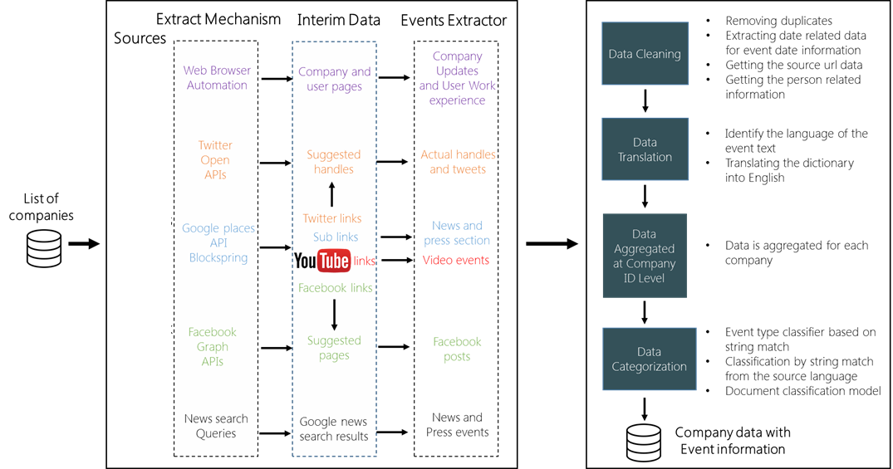



Process Approach
Data
Marketplace
Analyst
Reports
Company
Websites
News
Aggregators
Data Processing & Classification
Data Extraction
Social
Media

Slide 22
Thank You!
www.LatentView.com
| Princeton | San Jose | Seattle | London |
Chennai | Singapore |

